Slide 1

Chapter 8
Media Serving and File Uploads

Slide 2

Objectives
This chapter starts by introducing you to media files and then teaching you how to set up Django to serve them.
You will then look at some enhancements that Django provides specifically for working with image files and use the Python Imaging Library to resize an image.

Slide 3
Introduction
Media files refer to extra files that can be added after deployment to enrich your Django application.
They are extra images that you would use in your site, but any type of file (including video, audio, PDF, text, documents, or even HTML) can be served as media.

Slide 4
Introduction
A view (called static) that serves static files in development.
Static file finders to customize where assets are found on your filesystem.
The collectstatic management command, which finds all static files and moves them into a single directory for deployment.

Slide 5
Static File Serving
The URL mapping that is created is roughly equivalent to having the following map in your urlpatterns:

Slide 6
Static File Serving
Any URL starting with settings.STATIC_URL (which is /static/ by default) gets mapped to the static view.

Slide 7
Introduction to Static File Finders
A static file finder could be thought of like a plugin. It is a class that implements methods for converting URL paths to disks and iterates through the project directory to find static files.

Slide 8
Introduction to Static File Finders
When using the collectstatic management command. This gathers up all the static files in the project directory and copies them to a single directory to be served by the production web server

Slide 9
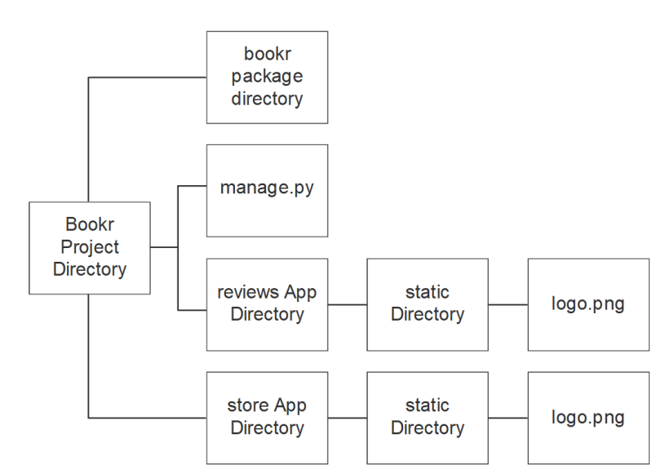
Static File Namespacing
Directory layout with static directories inside app directories.

Slide 10
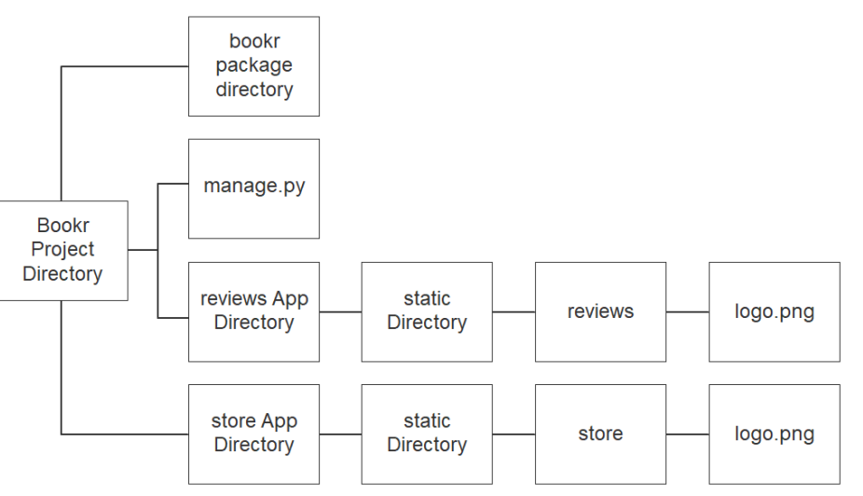
Static File Namespacing
Directory layout with namespaced directories

Slide 11


Generating Static URLs with the static Template Tag
Django uses /static/ as STATIC_URL. If we wanted to generate the static URL for our logo.png file, we would use the tag in a template like this.
The output inside the template would be this:

Slide 12
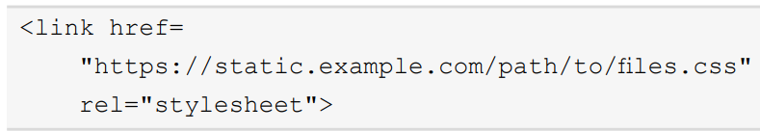
Generating Static URLs with the static Template Tag
The following is for the CSS link.

Slide 13
File System Finder
add extra directories to the STATICFILES_DIRS list

Slide 14
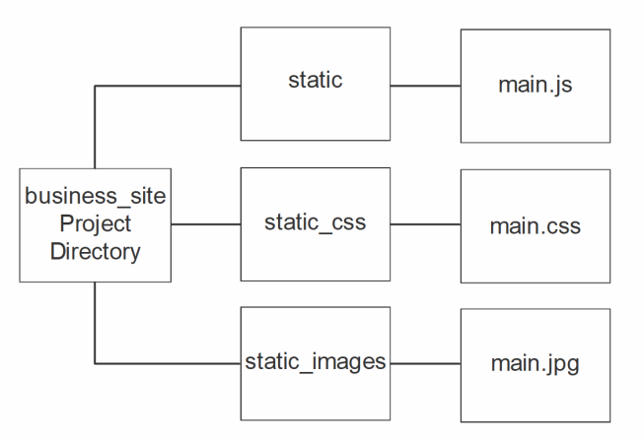
STATICFILES_DIRS Prefixed Mode
Directories layout for use with prefixed URLs.

Slide 15
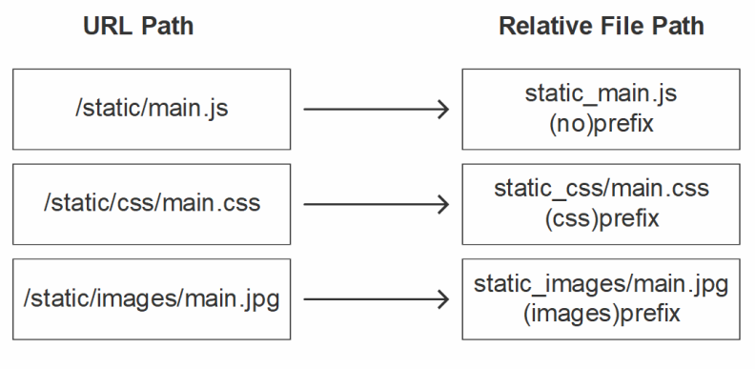
STATICFILES_DIRS Prefixed Mode
Mappings of URLs to files, based on the prefix.

Slide 16
Upload file

Slide 17
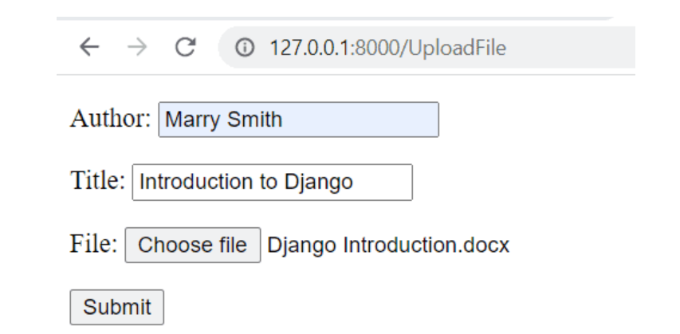

Slide 18
Create app
Create Project And App: First and foremost, we must develop a project and an app. So, to create it, use the defined code below
# Project
django-admin startproject PythonGuides
# App
python manage.py startapp UploadApp

Slide 19
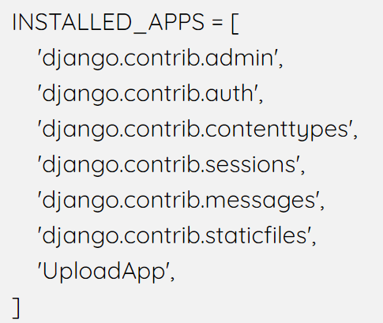
Install App:
After that, the project and app were successfully created. Now, you must install an application. You must include our app in the settings.py file to execute this

Slide 20
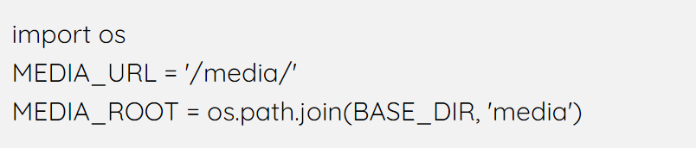
To save uploaded files, modify settings
First, import os.
Then, to server the media files, we use MEDIA_URL.
After this, to specify the root path where the file will be saved, we use MEDIA_ROOT.

Slide 21
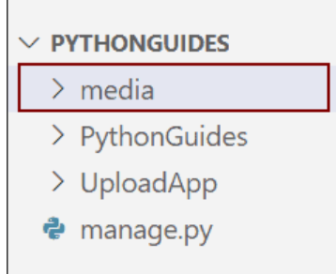
Media Folder
In the project folder, make a new folder called ‘media’.

Slide 22
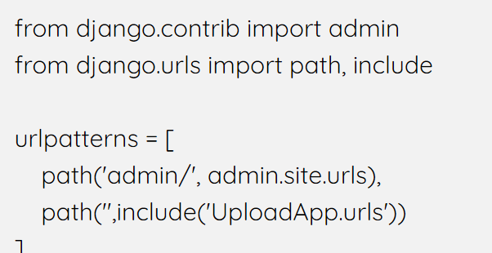
Project URLs
You must include a link to your newly developed app. Add the following code snippets to PythonGuides’s urls.py file.

Slide 23
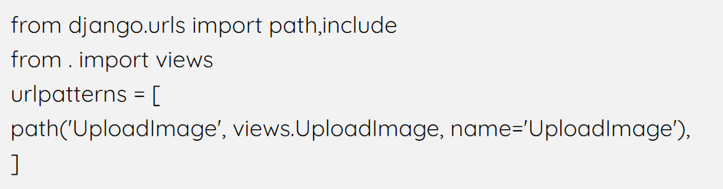
App URLs
The path to the function views must be included. Add the following code snippets to the UploadApp’s urls.py file.

Slide 24
Create Model
In models.py, create a new Django Model “Course” and then add the following code.
Here, we define the model CharField, which store the name of the author who upload a image and also the title of the image.
To upload the images, we use ImageField.
The upload_to option defines that image will saved under images directory within the media directory.

Slide 25
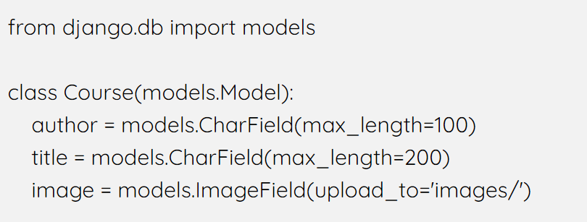
Create Model

Slide 26
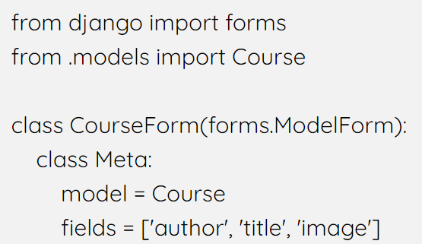
Create Form
We’ll now import the “Course” Model into forms.py and create the “CourseForm” ModelForm.

Slide 27
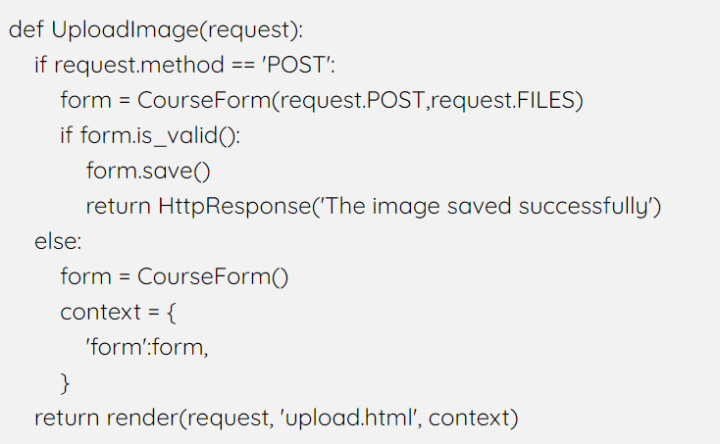
Create Views

Slide 28
Create Views
Here, we create the UploadImage function which check whether the request method is POST or not.
After this, we simply add a request.FILES along with the request.POST to the form method.
Then, we use the is_valid() method in view functions as it returns values as True and False.
And in last, we return to HttpResponse and also render to HTML template.

Slide 29
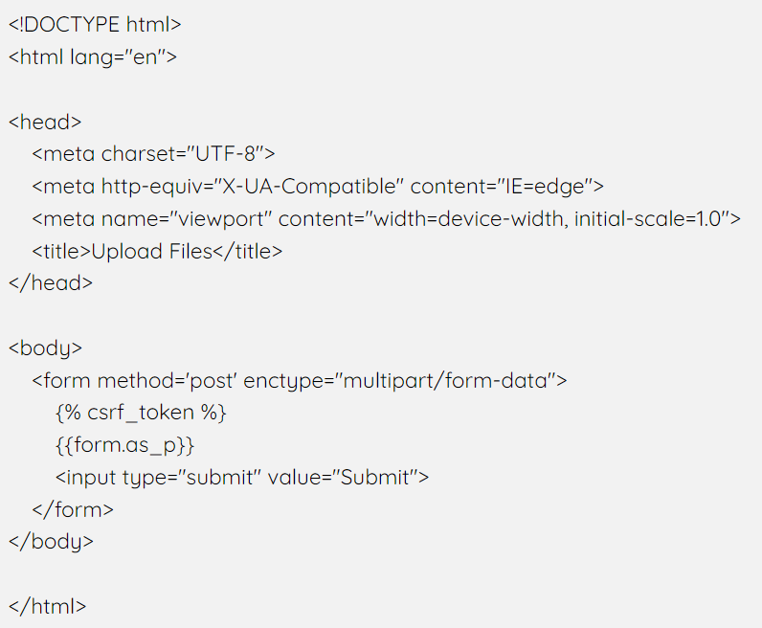
Create HTML Template

Slide 30
Create HTML Template
Now, create the <form> attribute in the template file.
Next, add the enctype =”multipart/form-data” otherwise, the form won’t work.
We also use the csrf_token tag in form to avoid malicious attacks.
Then, we use form.as_p tag to render Django forms as a paragraph

Slide 31
Django Database Migrations
# Make Migartions
python manage.py makemigrations
# Migrate
python manage.py migrate

Slide 32
Summary
We showed how to use Django's staticfiles app to find and serve static files.
We used the built-in static view to serve these files with the Django dev server in DEBUG mode.
We then demonstrated how the collectstatic command copies all the assets into the STATIC_ROOT directory, for production deployment.

